Slide 1
Jo Warsop Cantrell Primary School Priority Family Lead
Notes:
I trained in Sept 16 – 3rd attempt to complete!
This was the second family I had been allocated so all was new to me.

Slide 2
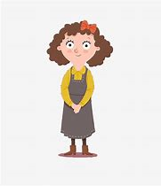
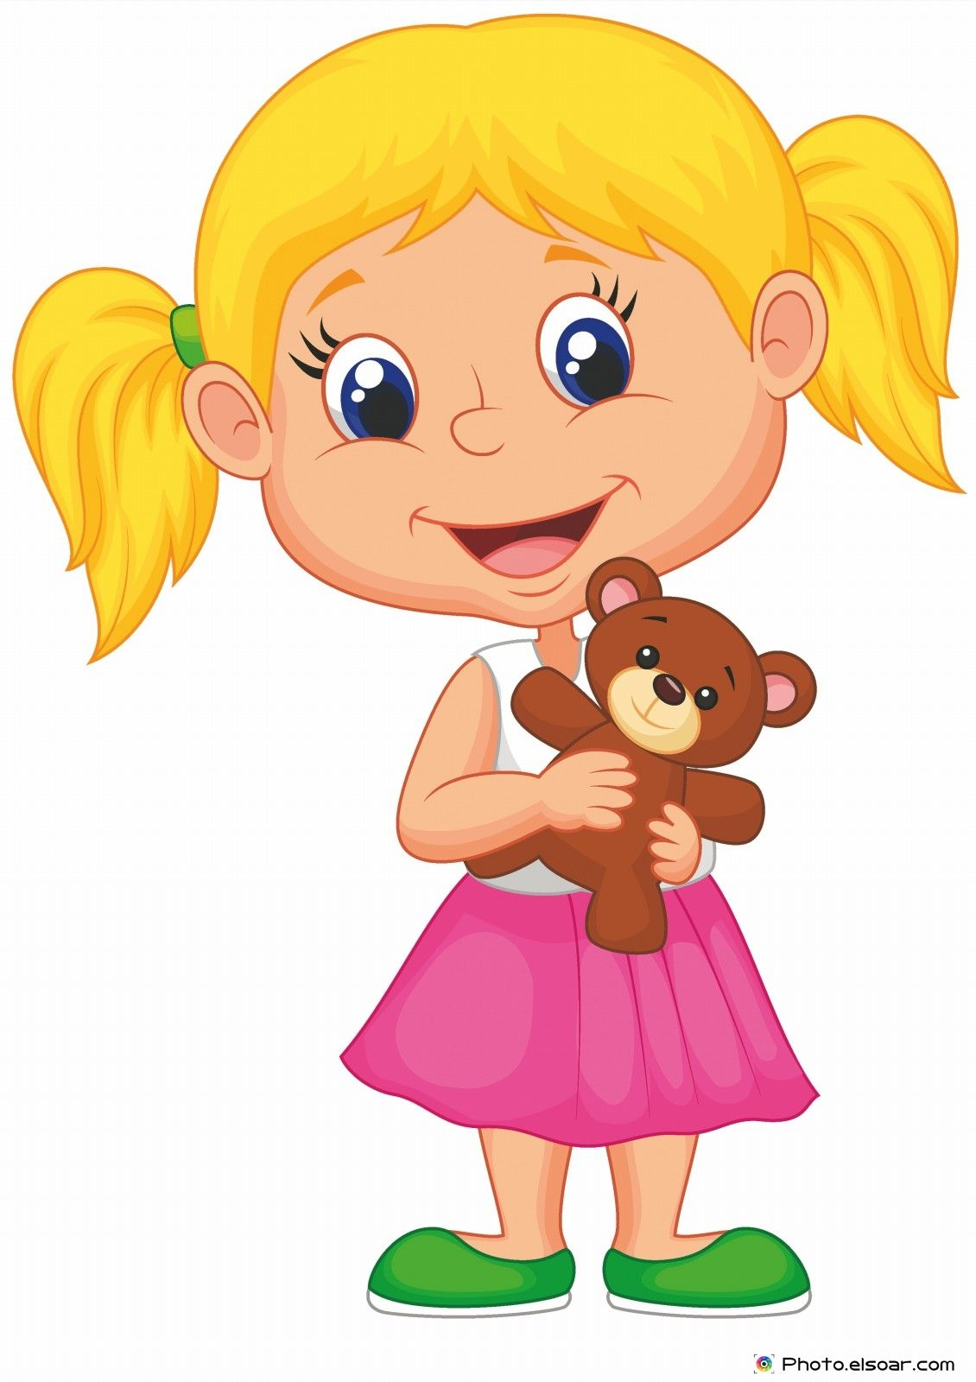
Family A
Notes:
Family A is made up of mum. Mum is currently out of work due to anxiety and is financially responsible for all 3 children..
Child A is 17 and is currently not in full time education or employment and lives at home.
Child B is 15 and lives at home. He attends school full time and is doing well, working hard and has a good peer group. He supports his mum by listening to her, looking after child c and being there when she needs him. He is her rock.
The boys birth father lives in a neighbouring city and does not have contact with child a however child b visits regularly. He offers little support when issues arise and mum is left to deal with it all alone. He feels like he doesn’t fit in and has not had a positive male role model.
Child C is 5 and has recently been diagnosed with Autism. She is currently in nappies.
Her father (step father to the boys) lived in the house up until recently when he moved out to live with his parents. This impacted on all concerned. Child A then felt he was the male of the house and in charge.

Slide 3
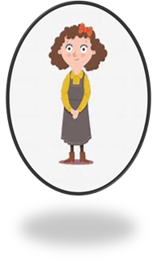
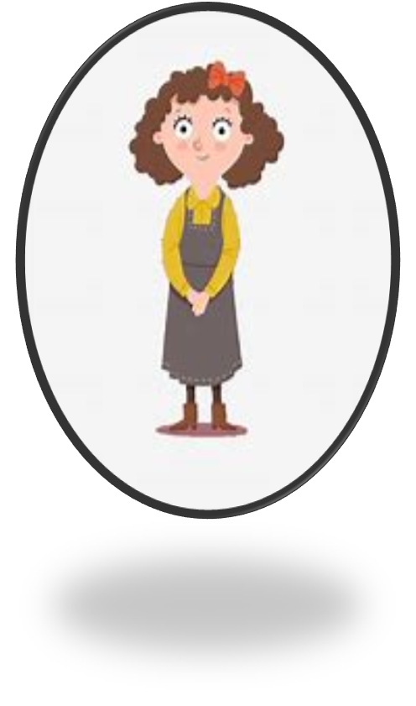
Why did ‘Family A’ become a Priority Family?
Domestic Violence incident was reported. The police were called after an altercation between mum and dad.
Whilst at the job centre mum discussed her concerns about Child A and his drug use, choice of criminal activities, anti-social behaviour and his controlling, demanding behaviour towards her.

Slide 4
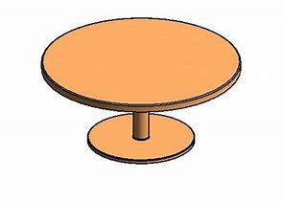
Mum
Me - Priority Family Lead
Mums friend
Priority Family Accredited Practitioner – linked to Cantrell
Meeting One – around the table
Local Police Officer
Department for Work and Pensions - DWP
Secondary School Year Manager
Notes:
Having all involved with the family around the table really helped us to gain a holistic view of the family and the support that could be offered, shared and sought from the connected agencies. This led to a plan being created with named people attached to the targets set.

Slide 5
What do we need to see change? | How are we going to do this? | Who do I need to help me? | When are we going to do this by? | How will we know things have changed | What could happen if Nothing changes? | How are we doing?
Child A to become financially independent and receive the benefits and financial support he is entitled to. | DWP to work with him and mum | DWP Mum | ASAP – dependent on how he co-operates and engages | Child A will be in receipt of benefits. | Child A will remain financially dependent on mum.
Child A takes part in education or employment. | Book an appointment at the job centre. JWarsop to provide details of job and training opportunities. | JWarop | ASAP – dependent on how he co-operates and engages | Child A will be in full term employment or education. Child A completes job applications. | Child A will remain in the benefit system.
Child C to be dry during the day. | Contact the incontinence nurse regarding this. | JWarsop Incontinence nurse | 1 week to make an appointment | Child C will be dry and no longer requiring nappies. | Child C will remain in nappies. Child C could be prone to sores and infections.
Child B taking time for himself. | School to speak to Child B re. his role in the family and if he feels a need for further support. | Year manager | 1 week
Mums mental health to improve | Make an appointment with the doctors | Mum | Within 1 week | Mums anxiety will have reduced. Mum will deal with situations in a calmer manner. | Mum could have a break down. Mum could attempt suicide.

Slide 6
What do we need to see change? | How are we going to do this? | Who do I need to help me? | When are we going to do this by? | How will we know things have changed | What could happen if Nothing changes? | How are we doing?
 |  | Regularly take prescribed medication | Mum | ASAP
 |  | Have a safety plan for if mum ever feels low in the future | Mum JWarsop Mums friend | ASAP
Child A to refrain from criminal activity and anti-social behaviour. | Encourage Child A to apply for job or education opportunities. | Mum DWP JWarsop |  | There wont be any anti-social reports. Mum will inform that his poor attitude has reduced and his admissions of anti-social behaviour lessens. | Be arrested.
 | Provide him with suitable social activities. | JWarsop KEaves |  | He partakes in an out of school time activity.

Slide 7
Meeting 2
During the second meeting mum disclosed that she had been raped.
Rape Crisis Team
GP referral for STD’s
Report it to the police
Mum contacted them and made an appointment to visit
Mum did not want to do this as at this time as she did not felt strong enough
Notes:
We discussed mum making contact with the rape crisis team. She said that she had contacted them. She was informed that they would keep the information on record for future reference if mum ever changed her mind on reporting this to the police.
Discussed the importance of reporting this crime so it doesn’t happen to others.
Mum stated that she would contact her GP.

Slide 8
Meeting 3
Mum disclosed a county lines allegation.
Child A informed mum that he had been collecting and selling crack cocaine for money.
Radford
Loughborough
He had a shortfall of £800 that he owed the dealer.
£1000 marker had been placed on him and he was unsure what to do.
Mum and Child C went to stop with the in-laws as she feared for their safety. Child B was at his birth fathers for the weekend and Child A went to stop with his girlfriend.
They lived away for a week.
Notes:
Mum was incredibly anxious during this meeting.
She disclosed this information to myself.
He stated that he owed £800 to the dealer – he had a shortfall.
He then returned home and learnt that a £1000 had been placed on his head.
They moved out and stayed away for a week.
I went on to discuss this with my headteacher who advised that I either phone the police or mum had to contact them herself and gain an incident number. I immediately rang mum and she stated that she would contact the police herself and bring me the incident number. I also stated that a Marf would have to be completed as there were younger siblings in the house. Mum brought in the incident number in the following day and I checked this out by contacting the officer she disclosed to.

Slide 9
Since the disclosure and returning home . . . .
Mum’s anxiety heightened as every time there was a knock on the door she feared who was on the other side.
No repercussions have occurred.
Child A now leaves the house infrequently.
School completed a MARF due to concerns around the safety of the younger siblings.
Notes:
We discussed mum returning to the GP and an appointment was made. We always discussed mum re-referring back to ‘Let’s Talk Wellbeing’ as she had previously been supported by them.

Slide 10
Child C was referred to ‘Explore Families’ due to the children being exposed to substance misuse in the family home.
Mum consented to this work taking place.
1:1 work has since been completed in school with Child C. This service is now closed to the family.

Slide 11
Life now after 5 meetings . . . .
Child A is now in paid employment working on a building site.
Child A has partaken in no further criminal activity.
Child A received information regarding local job and training opportunities.
Child B continues to thrive at school and still supports his mum.
Child C has received support from ‘Explore Families’.
Child C no longer wears nappies in school.
Child C is happy and flourishing.

Slide 12
Life now . . . .
Child C is being supported in school regarding her autism.
Child C is happy and flourishing.
Child C is being supported in school regarding her autism.
Child C is no longer working with ‘Explore Families’.
Mum and Child C’s father are reunited and co-habiting again.
DWP are working with mum to maximise her income.

Slide 13
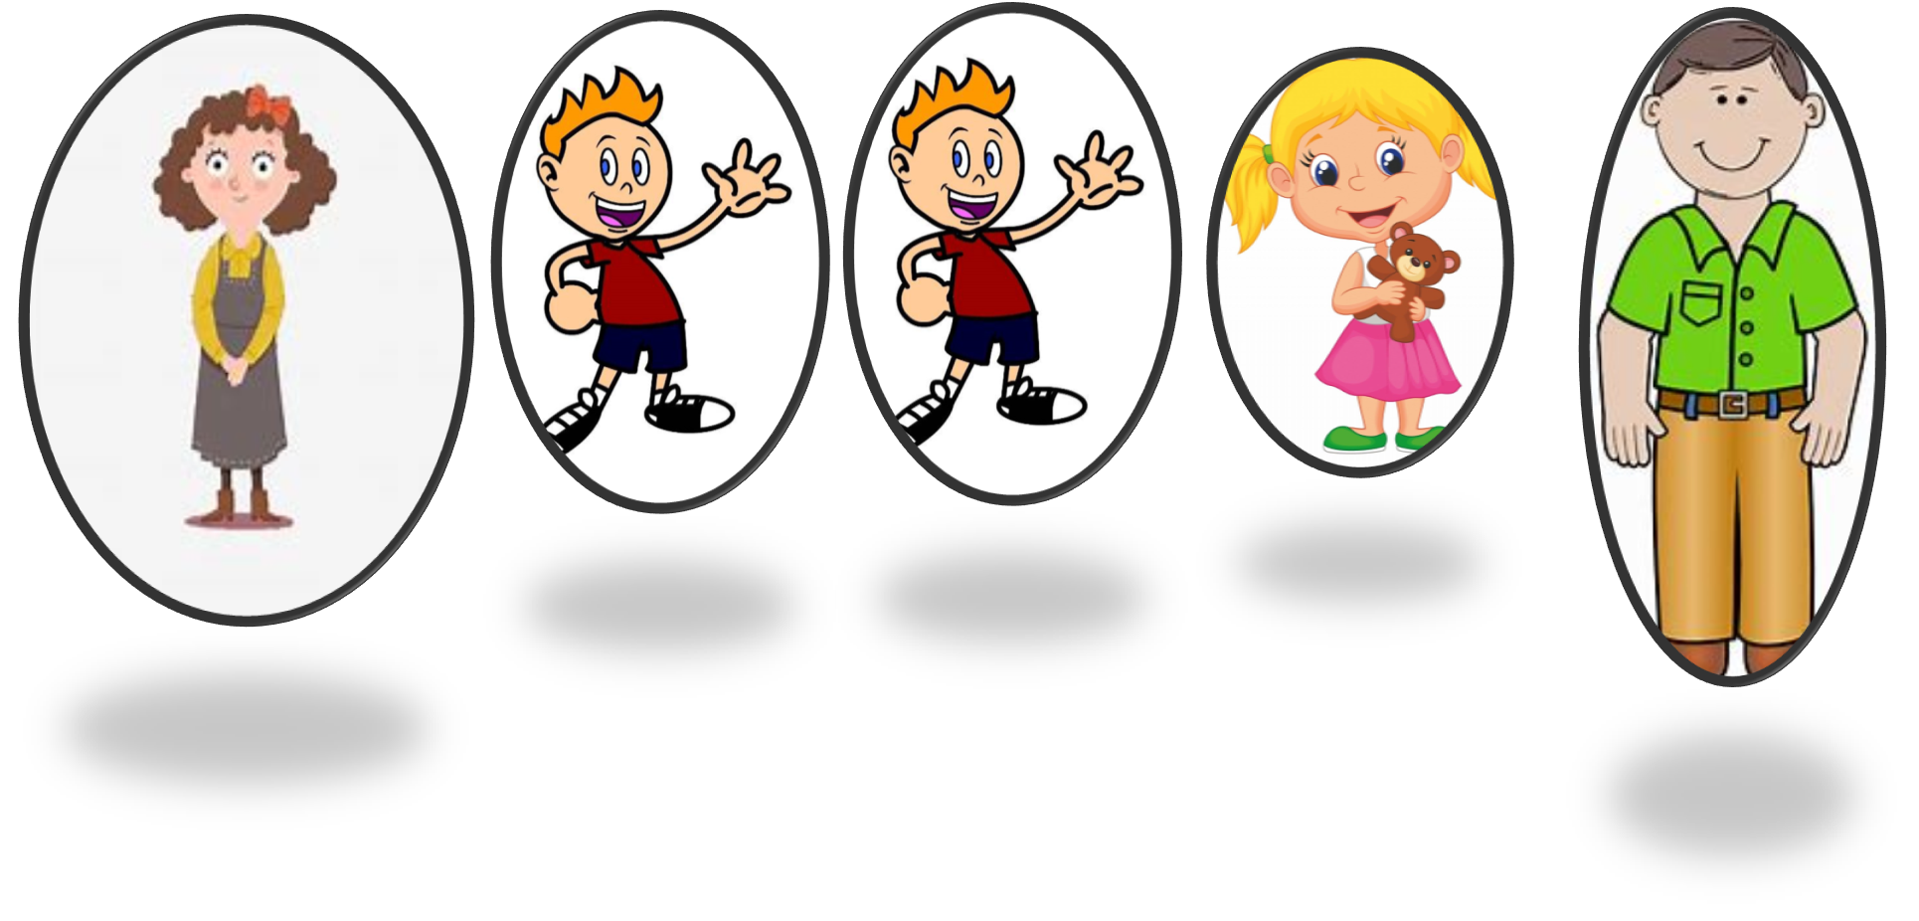
Life now . . . .
Mum is awaiting an appointment from ‘Let’s Talk Wellbeing’.
No further action regarding the rape has taken place.
No repercussions from the county lines allegation occurred.

Slide 14
The family are now closed to Priority Family’s.
Mum continues to stop by and catch up, as we have developed a positive working relationship throughout this whole family approach.

