Slide 1
Tax Facts – Tax Education for Schools
11th October 2018
Jenny Hardy and Lauren Rockley

Slide 2
What is Tax Facts?
Tax Facts is HMRC’s own tax education programme
Junior Tax Facts
Children aged 8-11
Covers: An Introduction to Tax, and What Taxes Pay For
Tax Facts
Students aged 14-17
Covers: About HMRC, Getting your First Job, Self Employment, The Hidden Economy, Construction Industry Scheme, and Personal Tax Accounts

Slide 3
Junior Tax Facts
For Children aged 8-11
Covers: An Introduction to Tax, and What Taxes Pay For
Session can be modified to fit to the schools standard lesson plan
Lots of interactive activities to keep the students engaged

Slide 4
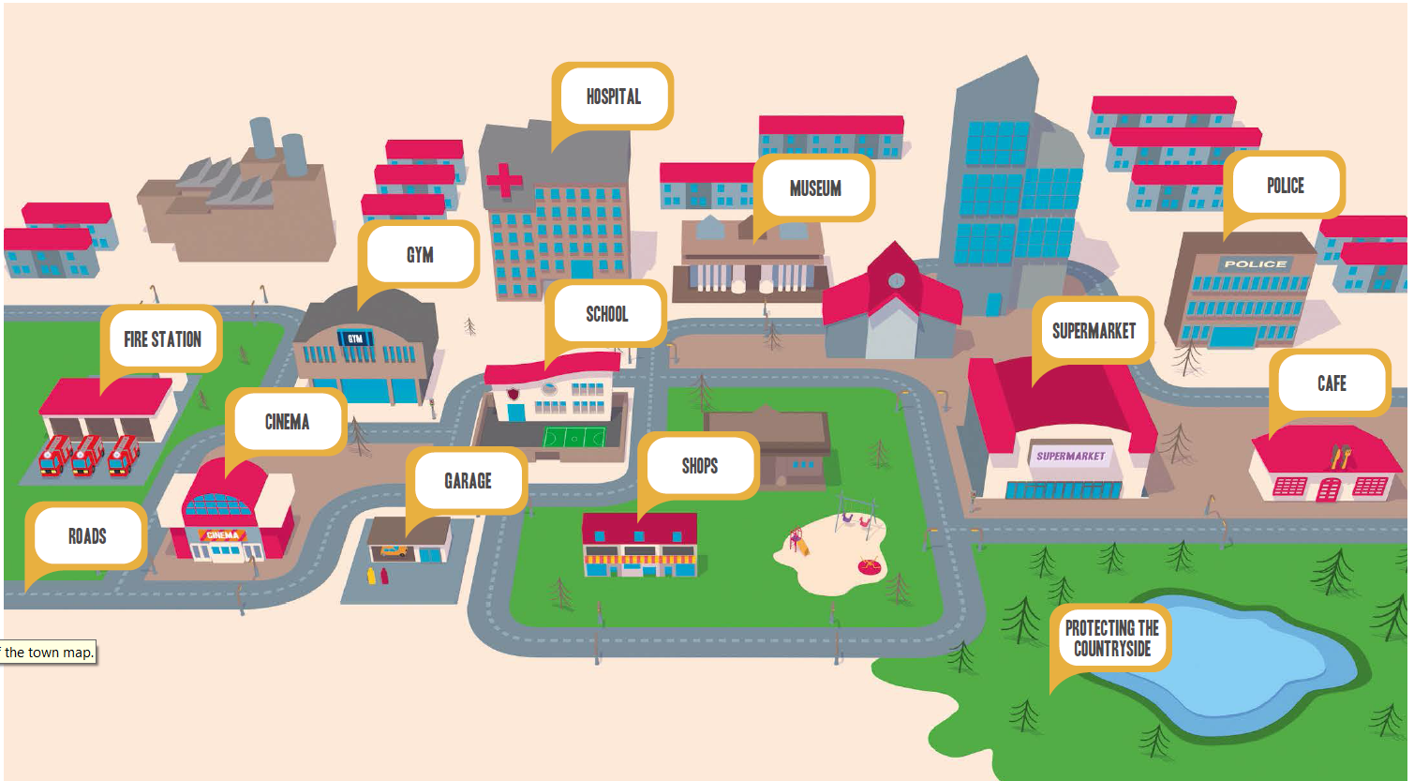
Activity One – What Do Taxes Pay For?

Slide 5
Extension Materials
Maths I: a group exercise on paying tax
Maths II: an exercise that explores the way the government spends the money that is collected through taxes, using a number of different graphs
History: a group or whole class discussion on Window Tax, its implications and consequences
Design: an individual or group exercise to design a poster, to show why paying tax is important.

Slide 6
Tax Facts
Learning objectives
Introduction
Animation
2 or 3 Activities
Highly dependent on the audience

Slide 7
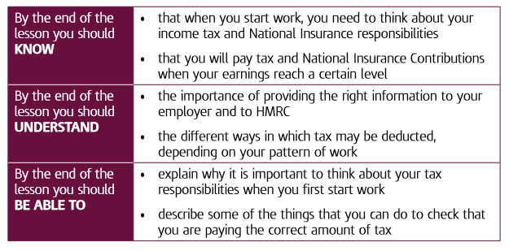
Learning Objectives

Slide 8
Exercise 1 – Chancellor For A Day
Working in small groups, decide if you could put an extra 10% tax on one things, what would it be?
Be ready to explain why you have chosen this

Slide 9
Estimating Tax Bills
How much tax would you pay on a gross salary of:
£15,000
→ You would pay £700
£25,000
→ You would pay £2,700
£50,000
→ You would pay £8,700
You’ll need to know:
Personal Allowance = £11,500
Tax Rate on income above the personal allowance to £43,500 = 20%
Tax Rate on income above £43,500 = 40%

Slide 10
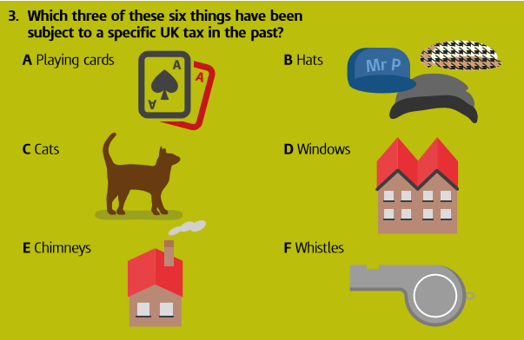
Quiz – Example Question
Notes:
Which three of these six things have been subject to a specific UK tax in the past? The correct answers are: A Playing cards – The tax on a deck of playing cards in 16th century England was 2 shillings and 6 pence (equivalent to £25 today), which was more than a lot of people earned in a month. B Hats – Hats were taxed in Britain from 1794-1811. D Windows – Window Tax was introduced in England in 1696 and in Scotland in the 1780s. People blocked up their windows in an attempt to avoid the tax, which was often referred to as “a tax on light and air”.

Slide 11
Methods of Delivery
HMRC Delivery
Assemblies
Classroom Sessions
School Delivery
All of the lesson plans are freely available to be delivered in schools
We are looking at offering some ‘Tax Facts Training’ sessions

Slide 12
How to Arrange a Session
If you are interested in arranging a Tax Facts Session for your school or have any further questions please contact:
Lauren Rockley lauren.rockley@hmrc.gsi.gov.uk
Jenny Hardy Jennifer.hardy@hmrc.gsi.gov.uk
We are happy to work with you to find the method of delivery that will be most appropriate for your school

Slide 13
Thank you
HM Revenue & Customs
Jenny Hardy and Lauren Rockley

