Slide 1
Exclusion and Inclusion
Michael Wilsher

Slide 2
Exclusions over time
2011 – Full cost recovery introduced
2012 – Permanent exclusions reach their lowest (39 across primary and secondary)
2013 – Full cost removed. Secondary and primary exclusions spike to 94 within an academic year.
2014 – Permanent exclusions peak at 126 in an academic year.
2015 to date – Strategies introduced to reduce permanent exclusion and increase inclusion. 17/18 permanent exclusions reduced to 96 in total.
Notes:
2013 and 2014 felt like, “the sky is falling down”.
Notes:
2010 academy programme announced by coalition government
2013 secondary Ofsted-gate
2015 Djanogly and NUSA Ofsted measures

Slide 3
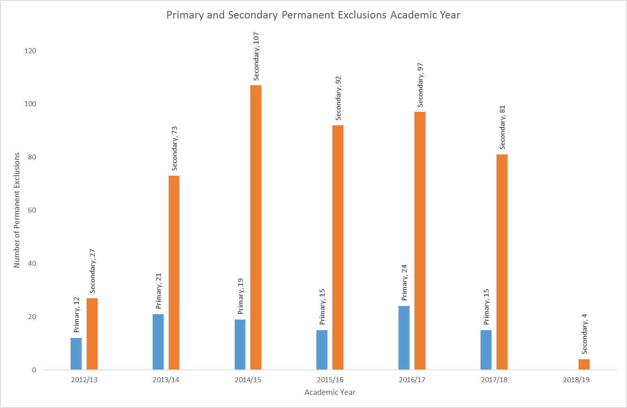
Permanent Exclusion Data
Notes:
But it was more than just one acorn…

Slide 4
The cost of permanent exclusion
1 permanently excluded pupils costs £12-54k per academic year to educate.
Nearly £3m additional funding is required from High Needs Funding each academic year to pay for alternative provision.
Research has estimated the overall cost to society for a pupil permanently excluded at £60k over their lifetime, which equates to nearly £33m to date.
Notes:
Avg £19k per placement with high end exceptional interventions costing £54k.

Slide 5
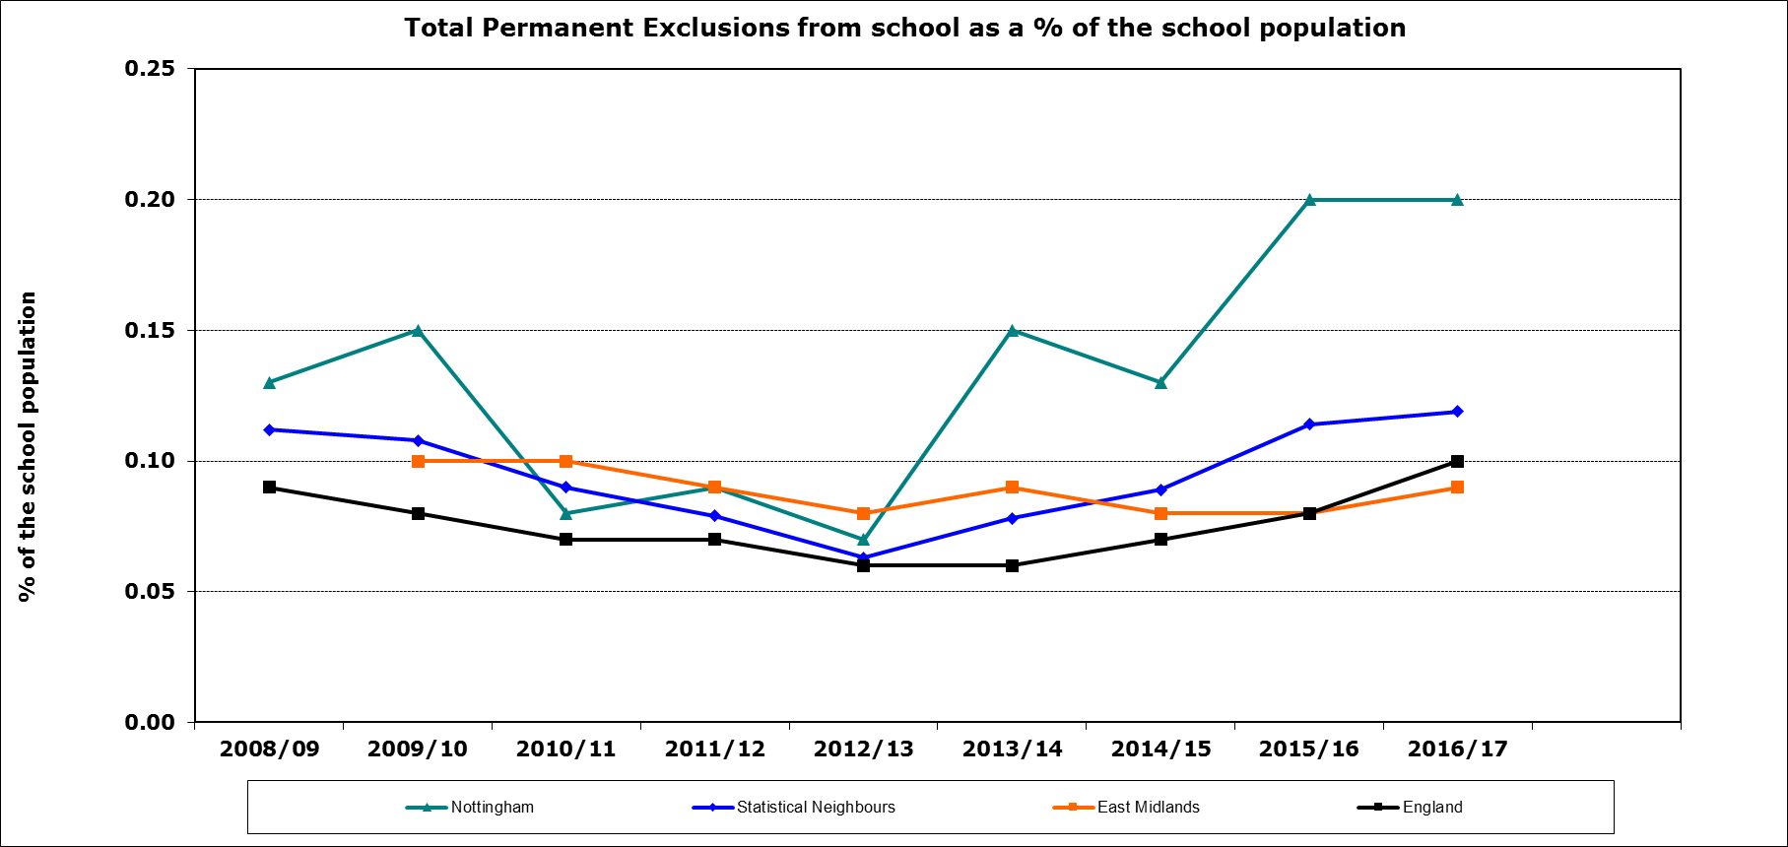
National Context
Notes:
Nottingham City is far exceeding statistical, regional and national statistics regarding permanent exclusion.

Slide 6
Reasons for Increase
Reduction in Council budgets
Pupils missing education
Loss of EMAG Team
School budget reductions
Ofsted changing expectations
Behaviour policies
Lack of LA presence
Drive for standards
Shortage of school places
Progress 8
Capacity of support teams
Oversubscribed PRU’s
Oversubscribed AP
Youth knife crime increase
Increasing behaviour cases
International comparisons
Lack of further quality AP
Special School Place Pressure
Cost of AP and support
Reduction in EWS
Social Care Capacity
RSC and EFS Scrutiny
Academisation
Increase in gang related incidents
Notice of concern
Impact of interventions
Pupil migration
Ofsted Inspections
Pressure from Gov Board
Stronger youth justice stance
Recruitment
Need for rapid improvement
Threat of Academisation
Attainment 8
Attendance
Support services traded

Slide 7
Scale and Perspective
The data and costs demonstrate a serious ongoing concern.
There is significant pressure on pupils, schools and local authorities; including national scrutiny (Ofsted, DfE, RSC)
We all want to same outcomes with pupils being successful and achieving.
We want to work together to improve inclusion with our combined skills and resources.
Notes:
All parties are concerned but all have differing challenges and pressures.
No school seeks out to be less inclusive, but we need to work together to improve our processes and focus our efforts where they are needed the most.

Slide 8
Inclusion Model
Currently in its third year of operation with secondary permanent exclusions reducing.
10 secondary schools now participate, reducing permanent exclusions by 18 from 17/18 and 11 from 16/17.
Creation of internal alternative provision and support systems.
Notes:
There will always be a need for exclusion, but our aim is to reduce the need for exclusion by seeking to support earlier and help reduce the impact on pupils, their families, schools and their staff and for society as a whole.
Not without challenges but Inclusion model schools and local authority services are working together to constantly improve the model and support eachother.
In model (10):
Bluecoat Academy; Bluecoat Beechdale Academy; Bluecoat Wollaton Academy; Fernwood School; Nottingham Academy; Nottingham Emmanuel School; Nottingham Girls' Academy; Oakwood Academy; Park Vale Academy; Trinity School.
Out model (7):
Ellis Guilford; Bulwell Academy; Djanogly City Academy; Farnborough Academy; Nottingham Free School; NUAST; NUSA

Slide 9
Fair Access
Fair access has adapted and developed over the years. Updated protocol being consulted.
Operates across all schools in primary and secondary schools to ensure equitability.
Funding secured for transition and reintegration.
Helps to reduce permanent exclusions.
Notes:
Fair Access has been the catalyst for development of alternative provision, KS4 EAL provision, commissioning educational assessments, pioneering the managed move process, creating support posts to aid engagement.
Comment about the work and support through BST, SEN with fair access cases.
In the last two years, we have helped avoided 7 Primary and 52 secondary exclusions through fair access support. In addition, there are another 22 cases receiving support to avoid exclusion.

Slide 10
Graduated Response
Most exclusions will need to demonstrate a graduated response, demonstrating support strategies implemented and failed.
School intervention > External intervention >
Support for High Level Needs funding and EHCP processes.
Notes:
Fair Access has been the catalyst for development of alternative provision, KS4 EAL provision, commissioning educational assessments, pioneering the managed move process, creating support posts to aid engagement.
Comment about the work and support through BST, SEN with fair access cases.
In the last two years, we have helped avoided 7 Primary and 52 secondary exclusions through fair access support. In addition, there are another 22 cases receiving support to avoid exclusion.

Slide 11
Routes to Inclusion
Nearly 40% of all exclusions are for persistent disruptive behavior.
Majority of Alternative Providers focus on SEMH needs.
Beneficial for us to have a common route for supporting SEMH pupils across the city.
Successful, evidenced based interventions
Collated support service thresholds and referrals
Support network and dedicated resources.

Slide 12
Routes to Inclusion
DfE Exclusion Guidance:
“Disruptive behaviour can be an indication of unmet needs. Where a school has concerns about a pupils behaviour, it should try to identify whether there are any causal factors and intervene early in order to reduce the need for subsequent exclusion.”
This model will help through:
Quicker identification assessments
Evidenced based interventions
Enabling greater success and quantify impact
Provide a robust graduated response if further actions are required such as Fair Access, EHCP or exclusion.
Notes:
Therefore reducing the route to exclusion by creating new routes to inclusion.

Slide 13
Conclusion
We can collectively reduce the route to exclusion by creating new routes to inclusion.
Fair Access
Alternative Provision
HLN
Inclusion
Inclusion Model
EHCP
R2i

Slide 14
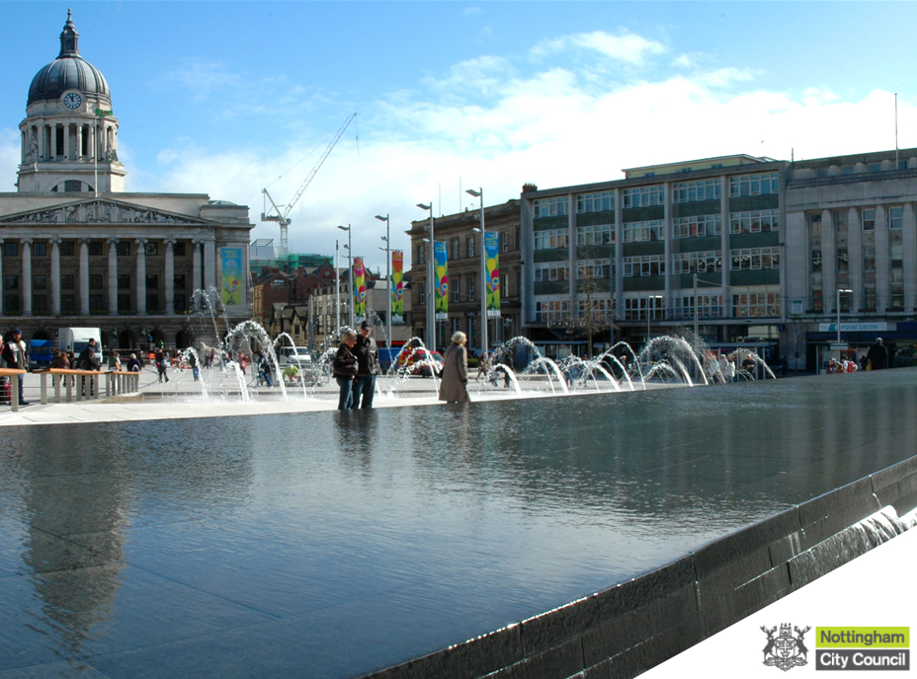
Michael Wilsher, Inclusion Officer
 michael.wilsher@nottinghamcity.gov.uk
 0115 8764626

