Slide 1


Children and Young People in the Youth Justice System with Special Education Needs and Disabilities
A New Perspective
Every child included
Marius Frank Director of E-Learning
Achievement for All
http://afaeducation.org/

Slide 2
Background
Every child included
DfE-funded project to help ‘secure better outcomes for children and young people with SEN in the youth justice system’:
Survey 86 YOTs covering 92 Local Authorities
11 Regional workshops attended by nearly 400 professionals in YOTs and SEN Teams
Advisory Group of over 30 experts
28 case studies and field visits
33 children and young people with SEN in the Youth Justice System interviewed
Notes:
The Youth Justice SEND Project brings together Achievement for All (AFA), the Association of Youth Offending Team Managers (AYM) and Manchester Metropolitan University (MMU) to support professionals to bring about a culture and behaviour change around effective SEND joint working. It is funded by the Department for Education (co-managed with YJB and MoJ) and builds on the pioneering work of both the Council for Disabled Children and Sheffield Futures.
The project endeavours to continue driving and embedding a culture-change around effective SEND joint working, transforming outcomes for young people with SEND who offend (or who are at risk of dong so).
Strands of work include:
a) Build local networks and share good practice: Creating effective, active and sustainable local networks of professionals and sector champions (including representatives of local authorities, Youth Offending Teams, health, social care, education providers and the secure estate) that are able to develop and implement practice that improves outcomes for these young people.
b) Continuing to build knowledge and understanding of the SEND reforms (building on last year’s work led by CDC and Sheffield Futures), particularly around how the reforms impact on current practice within the Youth Justice System through research and through the networks established through this project (sharing evidence based effective practice and innovation). Engage busy professionals with ideas that help meet their needs, including include new cross-cutting training.
c) Monitoring outcomes and improving the system: Help the sector monitor and analyse local authority SEN and disability support and outcomes of children and young people pre-, during and post-custody and address identified weaknesses and gaps (using evidence and data to best effect).
d) Working with young offenders and their parents: Building a good understanding of the challenges that children and young people with special educational needs and disabilities and their parents, have prior to, during and post custody.

Slide 3

Background
Every child included
+ new data available for the first time, matching records in the Ministry of Justice database with those held by Department for Education (Published Dec 2016)
Notes:
On 15 December 2017 a joint report between the Ministry of Justice (MOJ) and the Department for Education (DfE) was published that presented findings from a major data sharing project between the 2 departments. The focus of initial analysis from this data share was on understanding the educational background, attainment outcomes, characteristics and needs of young people aged 10 to 17 years who were sentenced in 2014 in England and Wales. This is the first time such an exercise has been conducted.
https://www.gov.uk/government/statistics/understanding-the-educational-background-of-young-offenders-full-report

Slide 4
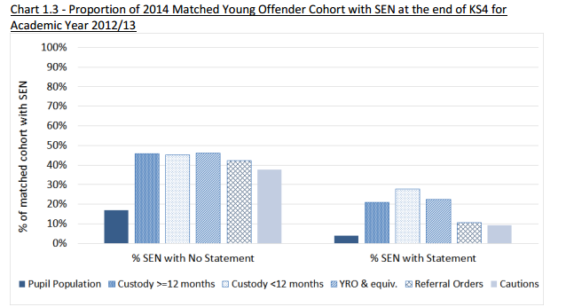
Findings
Every child included
From matched data exercise, around 60-70% of the youth justice population could have a degree of SEN compared to around 20% of the general youth population.
But is this the complete picture?
Notes:
The headline statistics confirmed a well-known and well-rehearsed thesis: that the prevalence of SEN in the youth justice system is considerably higher than the proportions within the whole school population.
‘Chart 1.3’ below (taken from the report) illustrates this clearly: 45% of those sentenced to less than 12 months in custody were recorded as having Special Educational Needs (SEN) without a statement (compared to 17% in state-funded schools in the matching year) and 28% were recorded as having SEN with a statement (compared to 4% in the same matched year).
46% of those sentenced to YROs (Youth Referral Orders) were recorded as having SEN without a statement. The equivalent figures for referral orders was 42% and for cautions was 38%.
If these matched data figures are summed and applied across the youth justice system, they suggest that 60-70% of the youth justice population could have a degree of SEN compared to around 20% of the general youth population.
The report was at pains to state that “it is not possible to conclude from the findings that having SEN means the young person will go on to offend. Many young people with SEN do not go on to offend”: rather, that young people who offend are more likely to have SEN.
This is not a new viewpoint. A number of studies in the past have highlighted the correlation (e.g. Speech and Language, Neurodevelopmental Disorders), and a number of resources have been made available to address specific identified needs (e.g. Sentence Trouble).
What is becoming clearer is the nature and extent of the issue. It is also probable that the data matching exercise has not uncovered the full extent of the disproportionality:
Doing Justice to Speech Language and Communication Needs; Communication Trust (2015)
Nobody made the connection: the prevalence of neurodisability in young people who offend: Children’s Commissioner (2012)
http://www.sentencetrouble.info/

Slide 5
Findings
Every child included
Results from the survey, from case studies, and from delegate feedback suggest that, for some young people, their first accurate and comprehensive assessment of SEN occurred at the point of entering the youth justice system.
If this is indeed the case, then the matched data exercise will only pick up those young people whose needs were identified ‘in school’.
“Many of our young people have unmet needs and that is due to them disengaging from mainstream services due to EBD issues. This then means that many of the young people drop out of education and have undiagnosed issues.”
“Why do we still find undiagnosed S&L issues in children who have been through the whole education system. How can they be missed?” Survey responses
“ Gateshead had a recent inspection and reported that the inspectors asked to know about all the YOT’s EHCP cases. Significantly all the cases on EHCPs were cases where the process had been triggered by the YOT rather than by schools.” Delegate Comment (Newcastle)
Notes:
Improvements in screening and assessment Over the past decade, it is fair to say that professionals working within the youth justice service have become more skilled at the assessment and identification of special education needs. The variety of tools that are being used, and the experience of those using them, has increased. Professionals who have worked in YOTs since their inception attest that, in the early days, it was rare to find a Speech and Language Therapist in the team. Indeed, the staffing of YOTs has changed to accommodate skilled professionals able to lead on screening and assessment.
With the recent introduction of Asset Plus, another layer of screening and assessment has been added, in addition to existing tools and processes (e.g. CHAT- Comprehensive Health Assessment Tool).
However, results from the survey, and from delegate feedback, also suggest that, for some young people, their first accurate and comprehensive assessment of their SEN occurred at the point of entering the youth justice system. If this is indeed the case, then the matched data exercise will only pick up those young people whose needs were identified in school.
https://www.gov.uk/government/publications/assetplus-speech-language-communication-and-neuro-disability-screening-tool

Slide 6
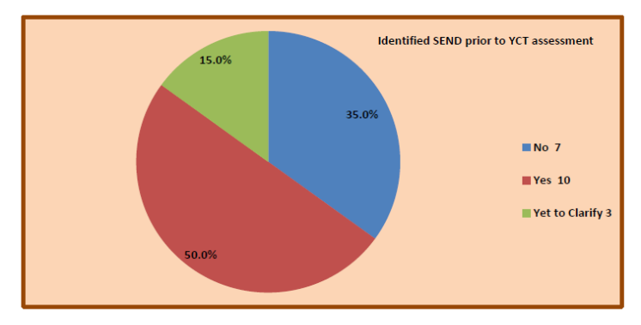
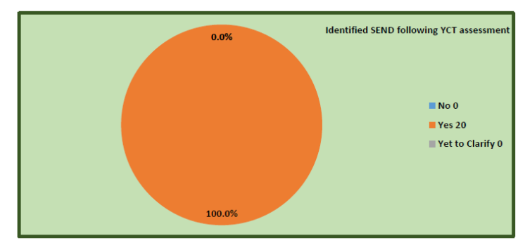
Findings
Every child included
Results from the survey, from case studies, and from delegate feedback suggest that, for some young people, their first accurate and comprehensive assessment of their SEN occurred at the point of entering the youth justice system.
If this is indeed the case, then the matched data exercise will only pick up those young people whose needs were identified ‘in school’.
North Yorkshire
Reassessment of YO cohort by specialist teacher identified all CYP having SEN
Notes:
In North Yorkshire, they have commissioned in a specialist teacher for 2 years on an invest to save project-
"It is a 2 year Invest to Save post to try to explore why our most vulnerable young people are struggling to achieve educationally.“
Part of the programme was a reassessment of a cohort of young people in the youth justice system
Case Study http://res.afa3as.org.uk/YJBubble/North_Yorkshire.pdf
All twenty young people were found to have degrees of SEN, whereas only 50% had identified needs prior to re-screening and re-assessment using a battery of tools.

Slide 7
Why?
Every child included
The prevalence of CYP with SEN in the youth justice system appears to be greater than statistics may indicate. It is therefore likely that most children and young people in the youth justice system have SEN. The possible reasons (from delegate and survey feedback and interviews with children and young people) for this could include:
Exclusion for poor behaviour (primary and secondary) …without adequate research and assessment into the reasons for poor behaviour. In some schools, there are SEN pathways and pastoral pathways. Do some young people get inadvertently trapped in procedural tramlines?
Persistent absence from school (and moving schools) making “graduated response” and building a case for/identifying SEN extremely difficult
‘Camouflaged’ SEN Some young people have developed a set of sophisticated (and at times, not so sophisticated!) ways of hiding learning needs
At times and in some contexts, inadequate Alternative Provision (in mainstream settings as well as PRUs and specialist units)
Inappropriate home education agreements
Notes:
Charities like Barnados have worked hard to illuminate the key issues, stressing the need for early identification and early intervention.
However, against a backdrop of increasing numbers of permanent exclusions happening nationally, at Key Stage 2 and Key Stage 3, it is a concern that:
The protective factors of being in mainstream school are being lost in a process that simply “removes the child” (with some experiencing significant delays before appropriate alternative provision or another mainstream school is found);
Graduated response and early intervention will not take place, at an age- or setting- appropriate time and place, meaning that the evidence-trail required to trigger EHCP processes is simply not there.
Statutory reporting and record keeping involving CYPs with EHCPs certainly helps identification and continuity of support. The situation is less clear if CYPs are on “SEN Support” provision in schools. It is quite possible that the Local Authority may not have the granular SEN Support data on these individuals, especially if they attend Academies outside Local Authority control. Waiting for census data may be too late.
In summary, systems and processes for the screening and identification of SEN for young people entering the youth justice system continue to improve. It is likely that the prevalence of SEN in the youth justice system is higher than the matched data report suggests, because, for some young people, the identification of need at the point of entry to the youth justice system appears to be the first time such an identification has taken place.
A number of factors appear to contribute to this:
Persistent absence
Camouflaged SEN (young people have learned to hide their disability behind layer upon layer of “front”- sometimes makes spotting SEN very hard
Movement between LAs
Exclusion for “bad behaviour” without proper assessment of why this behaviour is occurring
Moving schools (or “missing” from school) before a graduated assessment of need can take place
Inadequate alternative provision that does not meet the real needs of a child (part time timetables etc.)
Some home education agreements should simply not happen! Evidence though suggests that is a growing “solution” offered to parents… despite the family being totally unprepared or ill-equipped to do this
Currently, data is not collected by YOTs in a format or detail that enables a clearer picture to be established, such as:
The number/type and extent of SEN within annual YOT cohorts
The number of CYPs with SEN (below the level of EHCP) that have no previous record of SEN Support
The number of CYPs that are referred by YOT for EHCP assessment without any previous record of SEN referral or assessment
It is an objective during Year 2 of this Project to understand the nature and extent of “under-identification” through intensive data work in five Local Authorities.
A further contributory factor could potentially be a failure to match 30% of the data records in the MoJ system with those in the DfE database (around 500,000 cases). Some of the reasons for this significant gap are well rehearsed:
Young People offended in England or Wales and were educated in Wales, Scotland, Northern Ireland or outside of the United Kingdom
Different names were recorded (potentially due to the offender changing their name or reporting a different name) on the NPD and the PNC
They have a common set of characteristics (i.e. the same name, date of birth and/or postcode) that make it difficult to determine a unique match across the datasets
Internal (e.g. Romany families) and external migration (new immigrants) could also be contributory factors. Persistent absence for a variety of reasons also cannot be ruled out, meaning that records do not exist in the National Pupil Database.
Not Present and Not Correct- Understanding and Preventing School Exclusions (2010)
https://www.gov.uk/government/uploads/system/uploads/attachment_data/file/577542/understanding-educational-background-of-young-offenders-full-report.pdf p.23-24
Intensive work in 5 Local Authority areas during Year 2 of this project will attempt to interrogate local data to close the matched data gap.

Slide 8
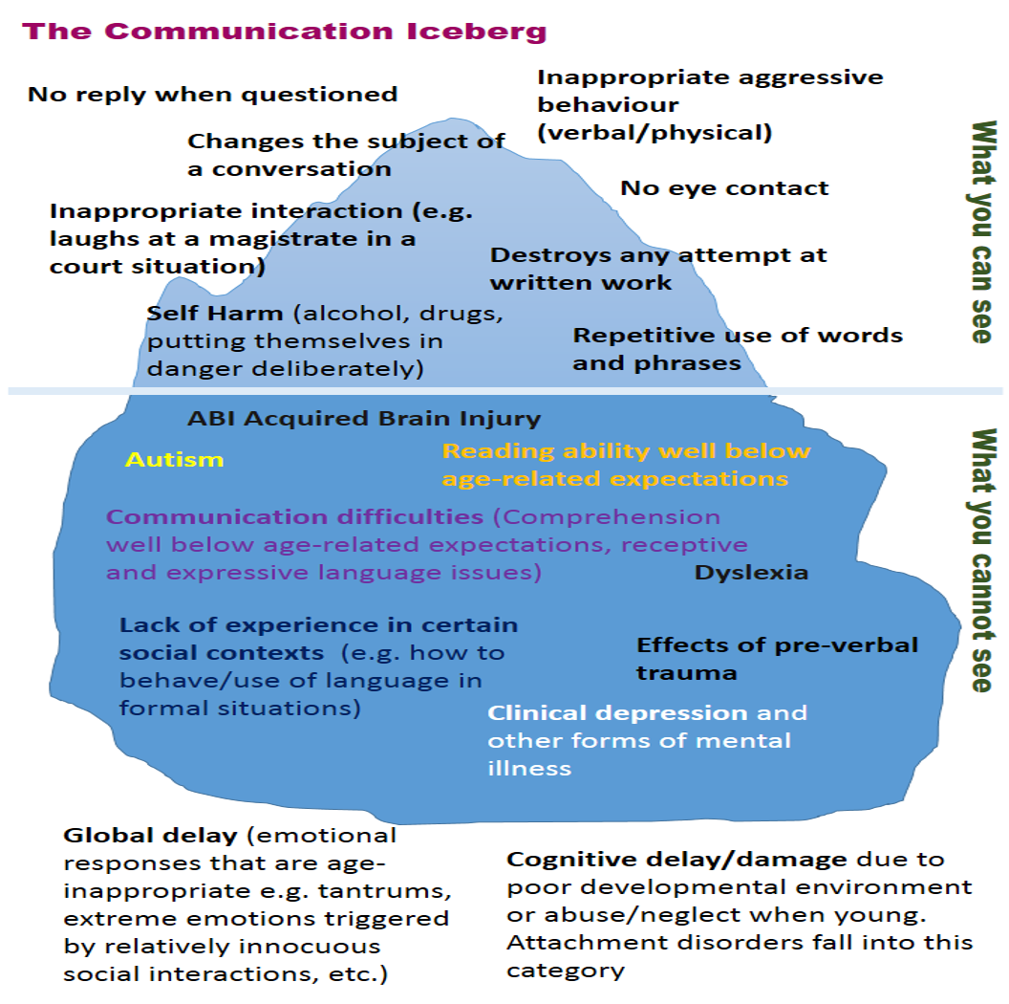
Conclusions
Every child included
Young people with SEN entering the youth justice system are uniquely vulnerable
This graphic is taken from the Youth Justice SEND Bubble, a comprehensive on-line learning and training resource which is free for any professional working in youth justice.
Notes:
This is a graphic from The Bubble that describes hidden SEN and the impact on observable behaviour
CLICK ONCE to move the graphic to the bottom segment of the iceberg.
This is an opportunity to “sell” The Bubble and the resources contained within it, and also to explore the nature and extent of “hidden disability”.

Slide 9
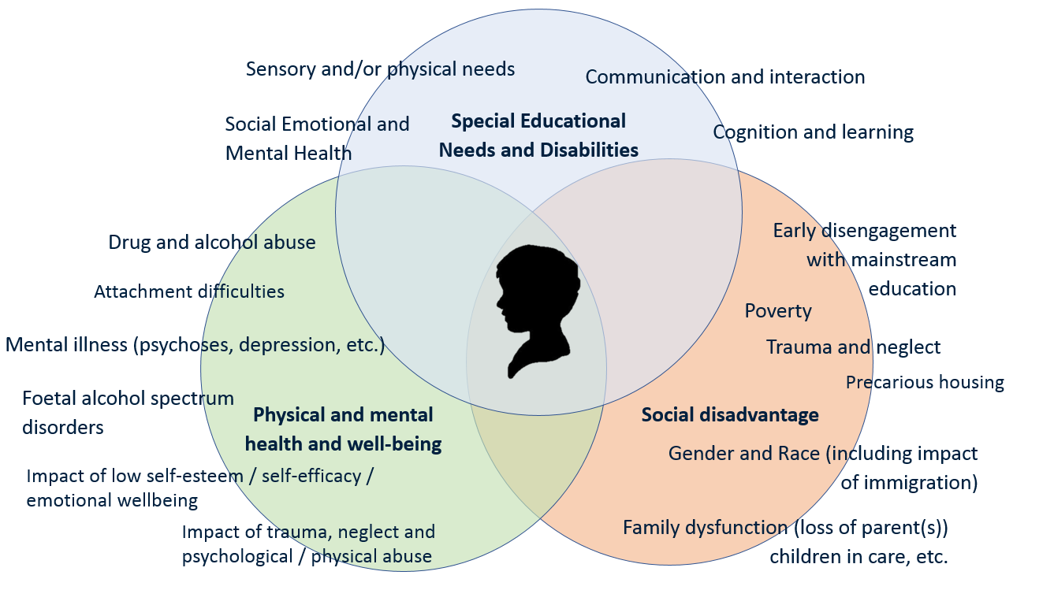
Conclusions
Every child included
Young people with SEN entering the youth justice system are uniquely vulnerable
Graphic taken from the Youth Justice SEND Bubble
Notes:
Appreciation, assessment of and meeting complex needs. Children and young people entering the youth justice system are commonly beset by multiple, high level, complex needs. Where there is a degree of (sometimes unassessed or unidentified) special educational needs these can conflate with complex social/structural disadvantage (including in many cases the intense emotional challenges of being “in care”) and mental/physical well-being issues. Holistic support plans have scope to take into account these conflating factors, leading to more effective joined-up provision that secures better outcomes.
We observed this practice using different approaches in Leeds and Darlington.
Their plans were effectively drawn up, actioned quickly and put in place whether the young person has an EHCP or not. These same areas also have a system-wide focus on protective strategies and positive outcomes in terms of education, employment and an independent adulthood. Also worthy of mention is the NHS Transforming Care initiative to support and protect neuro-diverse children and young people, and the SE7 Protocol (signed off by the Constabularies spanning 7 LA areas in the South East of England) designed to prevent the criminalisation of Looked After Children. Case Studies: Delegation of High Needs funding to Local Area Partnerships in Leeds (in which YOTs participate); SE7 Protocols to prevent the criminalisation of LAC; NHS England Transforming Care Partnerships to protect neuro-diverse CYPs; Darlington’s use of Troubled Families assessment tool in the case of every CYP that comes into contact with YOS

Slide 10
How we can make a difference
Every child included
“Screening out” rather than “screening in”
Holistic support plans have scope to take into account complex needs, leading to more effective joined-up provision that secures better outcomes.
Addressing Speech Language and Communication Needs is an absolute priority (the “window” of opportunity to secure better outcomes and life chances)
Strong links and information sharing with secure estate
YOS access to specialist provision for assessment (co-location) and support (CAMHs, SaLT, High Needs funding)
Strategic “visibility” young offenders (Safeguarding Panels, Clinical Commissioning Groups… it worked for Looked After Children!)
Linking YOS to Early Intervention, Troubled Families, Looked After Children and other preventative proactive local initiatives (including third sector)
Forensically analyse local “pathways to criminalisation” (postcode patterns and demographics, PEX patterns, persistent absence, alternative provision, home education patterns and reasons why not in mainstream settings)
Notes:
The challenges that need to be addressed are clear:
“Screening out” rather than “screening in” An important mindset… and perhaps a pointer to the skills required of the person doing the screening and assessment
Holistic support plans have scope to take into account complex needs, leading to more effective joined-up provision that secures better outcomes.
Addressing Speech Language and Communication Needs is an absolute priority (the “window” of opportunity to secure better outcomes and life chances)
Strong links and information sharing with secure estate Throughout sentence planning, monitoring and resettlement
YOS access to specialist provision for assessment (co-location) and support (CAMHs, SaLT, High Needs funding- a co-located service supports a team-around-the-child approach, and the development of specialist skills)
Strategic “visibility” young offenders (Surely CYP in the Youth Justice System with complex needs are amongst the most vulnerable and “at risk” within a local authority! Area. Safeguarding Panels (CYPs in YJS with SEN a standing item on the agenda), Clinical Commissioning Groups (so that SaLT provision is secured)… Increasing the strategic visibility worked for Looked After Children!)
Linking YOS to Early Intervention, Troubled Families, Looked After Children and other preventative proactive local initiatives (including third sector)
Forensically analyse local “pathways to criminalisation” (postcode patterns and demographics, PEX, persistent absence, alternative provision, home education patterns and reasons)

Slide 11
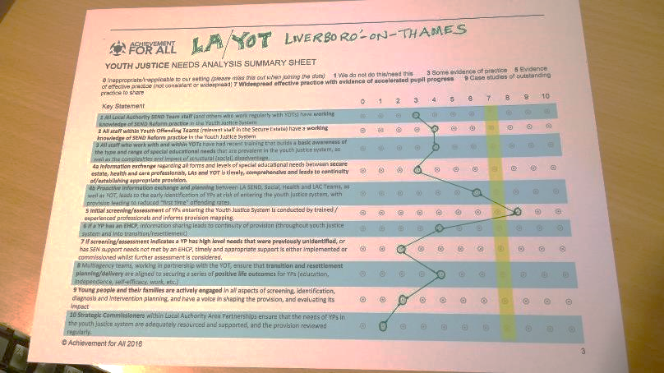
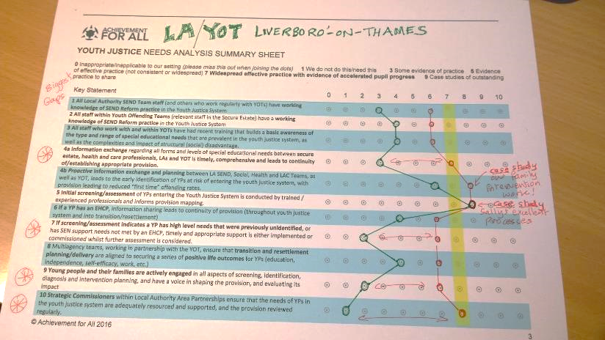

How we can make a difference
Year 2 developments: YJ SEND Quality Mark
Every child included

Slide 12
How we can make a difference
Year 2 developments (MMU Use of data research with five LAs)
Every child included
“In all five Local Authority areas there was an overall theme of fragmentation in the ways in which local services engage with the lives of vulnerable children and young people who may have SEND and are at early stages of involvement with the youth justice system.
Aspects of their lives are refracted through various data systems; they may be channelled through divergent pathways labelling them as presenting behaviour problems or as having SEND; and they risk a discontinuity of services if engagement with school is weakened, where SEND services are commissioned by schools.”

Slide 13
How we can make a difference
Year 2 developments (MMU Use of data research with five LAs)
Every child included
Key Questions for consideration
How might local authority, health and youth justice services share data more effectively, to support young people who may have complex needs and are at an early stage of involvement with the youth justice system?
How might local authority, health and youth justice services collaborate more effectively, to support young people who may have SEND and are at an early stage of involvement with the youth justice system?*
What scope might there be for including young people involved with the youth justice system within local processes for supporting ‘children in need’ or those who are regarded as vulnerable children?
*Especially if a child or young person is assessed to be “below the threshold of intervention”… but in two or three domains… with a history of ACEs (Adverse Childhood Experiences”

Slide 14
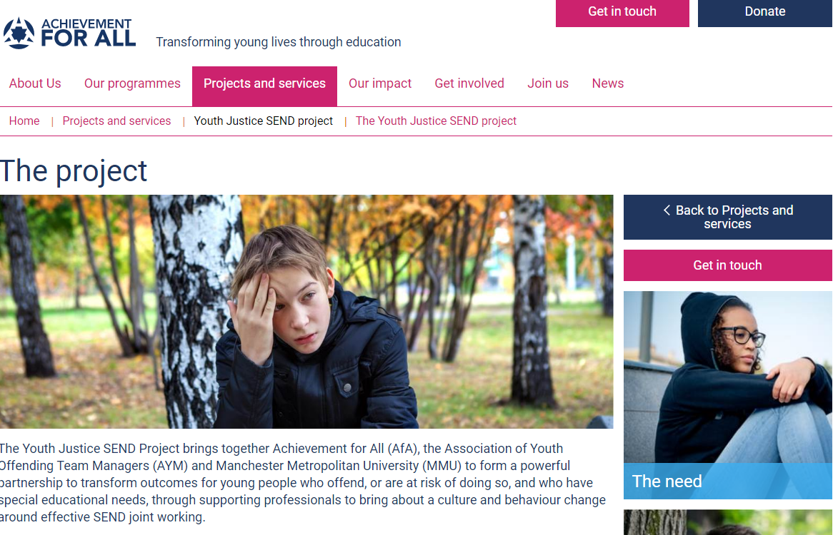
More about the Project
Every child included
More information and resources are available from the project website
https://afaeducation.org/projects-and-services/youth-justice-send-project/the-youth-justice-send-project/
Click here to sign up for our monthly Project Newsletter
Or contact the Project Team
Marius Frank
Project Lead and Director Achievement for All
e: marius.frank@afaeducation.org

