Slide 1
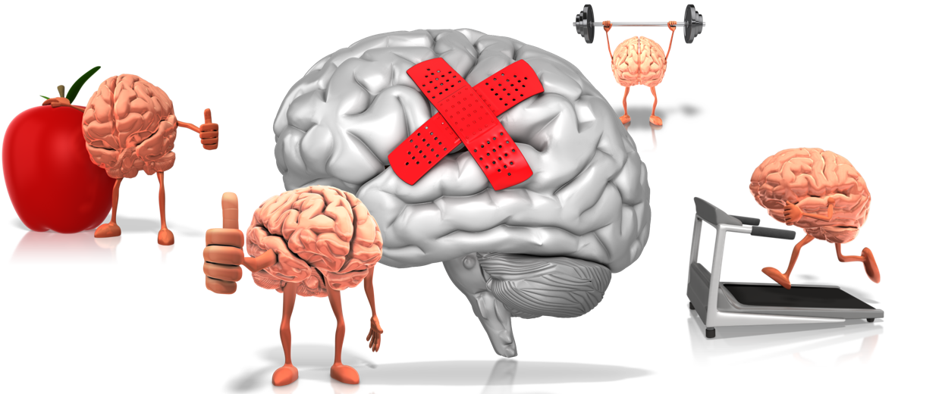
Improving learning outcomes through Achieving Wellbeing
Unlocking academic progress and lifelong achievement through emotional wellbeing and mental health
Marius Frank Director of E-Learning
Achievement for All
http://afaeducation.org/

Slide 2
Improving learning outcomes through Achieving Wellbeing
Aims of this session
Exploring the explicit link between wellbeing, learning, and learner outcomes
How the Achieving Wellbeing Programme aims to transform the climate and culture of the classroom, unlocking progress and academic achievement
How the Achieving Wellbeing Programme has been adapted to meet the needs of looked after (and previously looked after) children, in partnership with Virtual Headteachers in five LAs

Slide 3
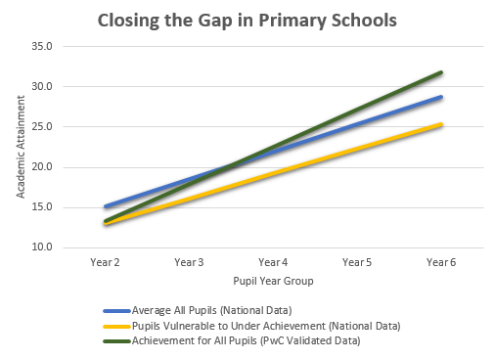
Achieving Wellbeing
What is it?
Achievement for All has helped to transform learner outcomes in thousands of partner education settings across the country, closing the gap, accelerating progress and driving social mobility.
Now, for the first time, a new programme is available to all schools, addressing the critical link between emotional wellbeing and progress and attainment for children especially the vulnerable, disadvantaged and those with special education needs.

Slide 4
Achieving Wellbeing
What can it do? 1/3
Achieving Wellbeing is designed to have a positive and sustained impact on critical cohorts of children and young people, supporting improvements in the learning environment that will enable achievement to thrive:
• Children and Young People receiving SEN Support (as well as those with EHCPs)
• Children in Care or on the edge of care
• Children and Young People with specific vulnerabilities (self-esteem and confidence, emotional self-regulation skills, etc.)
• Pupil Premium Cohort
• New migrants or Travellers

Slide 5
Achieving Wellbeing
What can it do? 2/3
The Government has recently signalled intent with a Green Paper: Transforming Children and Young People’s Mental Health Provision.
This programme enables schools, colleges and multi-academy trusts to stay one step ahead of legislative changes, and establish whole school proactive approaches that break down barriers to progress by addressing the climate and culture of the classroom, developing professional understanding of the impact of attachment, childhood trauma and neglect, and building core strength and resilience.

Slide 6
Achieving Wellbeing
What can it do? 3/3
It is also designed to support you, all front-line professionals in primary and secondary settings.
It is acknowledged that dealing with classroom behaviour issues is a major contributor to stress, anxiety and workload.
By addressing the climate and culture of the classroom, developing professional understanding of the impact of childhood trauma and neglect, and building core strength within cohorts of identified learners, barriers to progress will be dismantled.

Slide 7
Achieving Wellbeing-CLA
Improving outcomes for Children Looked After
The Achieving Wellbeing (CLA) Programme coaches and supports Designated Teachers to promote a whole school culture where the personalised learning needs of looked after and previously looked after children and their personal, emotional and academic needs are prioritised in order to improve wellbeing and attainment.
Quality of PEPs
SDQs
Measuring Progress
Northumberland 10 schools
Gloucestershire
7 Schools
South Wales
21 Schools
Barnet – no. of schools TBC
Kingston, Richmond, Windsor & Maidenhead 8 schools
2 colleges
Croydon
4 schools
Notes:
All starting between now and November. VSH are funding settings out of their top sliced Pupil Premium Plus funding. Inviting schools with their CLA on roll to apply. We’re working with each VSH to understand processes, needs, requirements re things like quality of PEPs, wellbeing measurement, support for previously looked after children.
Programme supports school to use SDQs and overlay wellbeing scores with termly progress/attainment for target cohort of CLA/previously CLA
Also have ongoing contract with Northumberland VS to establish regular CPD and practice sharing sessions for Designated Teachers, we also established a hub for DTs in Croydon
Haven’t gone out to more LAs yet until we get this properly underway so none officially in the pipleline although I am meeting with the chair on NAVSH in a couple of weeks.

Slide 8
Achieving Wellbeing
The explicit link between wellbeing, learning, and learner outcomes
An anxious, frightened or angry brain will not learn In the academic sense of the word

Slide 9
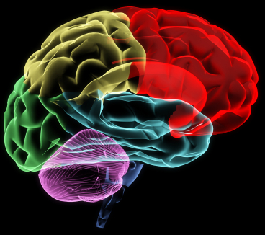
The Amygdala Hijack
?
A stimulus is received
(auditory visual, etc.)
The Thalamus detects a threat
Thalamus immediately triggers the primitive reactive “emotional” part of the brain (the Amygdala)…
?
… before messages reach the “thinking” part of the brain…
Adrenal glands release catecholamines
Heartbeat quickens
Breathing affected
Bloodflow affected
Fight flight freeze or flock behaviours triggered
….leading to fight, flight, freeze or flock reactive behaviours, fuelled by the release of hormones like adrenaline. Learning is blocked.

Slide 10
Achieving Wellbeing
The explicit link between wellbeing, learning, and learner outcomes
Red Zone
Fight or flight
Blue Zone
Freeze, shut down, unresponsive
STRESS
RECOVERY
STRESS
RECOVERY
On any normal day we encounter numerous stressors, situations that cause the body to accelerate, prepare for action (getting up late, missing a bus, anticipating a difficult meeting at work, etc.). These are normally followed by periods of recovery.

Slide 11
Achieving Wellbeing
The explicit link between wellbeing, learning, and learner outcomes
Red Zone
Fight or flight
Accelerator
Brake
Accelerator
Brake
Blue Zone
Freeze, shut down, unresponsive
Sometimes we can choose to step on the accelerator (“psyching up” before a game of rugby or an important meeting).
Sometimes we can choose to step on the brake (slow deep breaths, count to 10, meditate, sit quietly and still). This is emotional self-regulation.

Slide 12
Achieving Wellbeing
The explicit link between wellbeing, learning, and learner outcomes
Red Zone
Fight or flight
Blue Zone
Freeze, shut down, unresponsive
But what if you have lived a childhood in trauma, under threat, under stress? What if, because of your life experiences, your brain has not developed the ability to self-regulate, the connections between the “thinking” brain and the “reactive” brain (that triggers fight, flight or freeze behaviours) have not developed properly?

Slide 13
Achieving Wellbeing
The explicit link between wellbeing, learning, and learner outcomes
Conclusions
For some children and young people outstanding teaching will not lead to outstanding learning

Slide 14
Achieving Wellbeing
The explicit link between wellbeing, learning, and learner outcomes
Solutions
How to engage teachers and support staff in a wellbeing ethos and methodology*
*Particularly around the needs of CLA

Slide 15
1.1.1 What can we learn from eradicating cholera?!
The way to stop cholera becoming a debilitating and deadly disease is through environmental and social change
The way to treat cholera is through hospitalisation, antibiotics rehydration intravenously with body salts and fluids
Notes:
Cholera is a disease caused by micro-organisms. When ingested, they multiply quickly in the body, causing vomiting and diarrhoea. In severe cases this can lead to death. The treatment of the disease is rapid rehydration and the administration of body salts (electrolytes) and fluid, sometimes intravenously. But the way to stop cholera becoming a debilitating and deadly disease is through environmental and social change: 1) Access to clean drinking water 2) Treatment of sewage and human/animal wastes 3) Education: through good personal and community hygiene.​

Slide 16
1.1.1 What can we learn from eradicating cholera?!
As teaching professionals, we may not have the skills to treat mental health issues once they have taken hold. However, we do have considerable control and influence over the social and environmental factors in our classrooms, in our education settings, that can reduce the possibilities of mental illness occurring. What is more: through daily interactions that build self-esteem, confidence, resilience, self-efficacy and a sense of belonging, we can equip children​ and young people with the wellbeing tools that could act as protective factors against mental illness for their entire lives.
Notes:
Maybe an opportunity to discuss these statements?

Slide 17
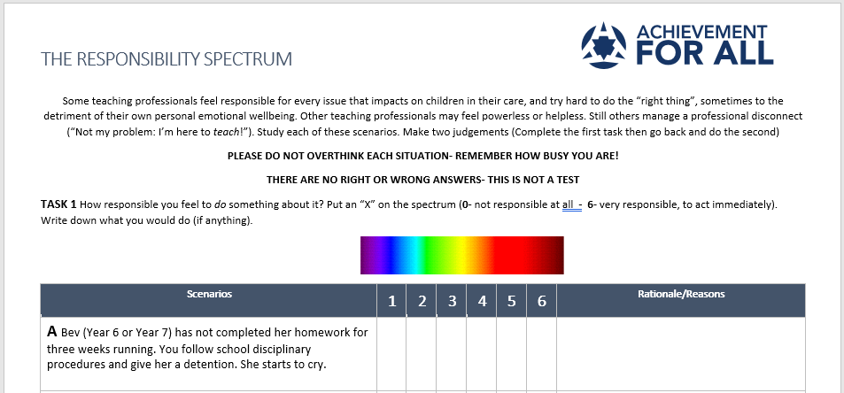
Activity 1.1.1
The responsibility spectrum
Notes:
You will need TOOLS 1.1.1 The responsibility spectrum- hold back the final sheet!
Some teaching professionals feel responsible for every issue that impacts on children in their care, and try hard to do the “right thing”, sometimes to the
detriment of their own personal emotional wellbeing. Other teaching professionals may feel powerless or helpless. Still others manage a professional disconnect
(“Not my problem: I’m here to teach!”). Study each of these scenarios. Make two judgements (Complete the first task then go back and do the second)
PLEASE DO NOT OVERTHINK EACH SITUATION- REMEMBER HOW BUSY YOU ARE!
THERE ARE NO RIGHT OR WRONG ANSWERS- THIS IS NOT A TEST
TASK 1 How responsible you feel to do something about it? Put an “X” on the spectrum (0- not responsible at all - 6- very responsible, to act immediately).
Write down what you would do (if anything).

Slide 18
Achieving Wellbeing
Setting the scene
Discussion
Could the "amygdala hijack" be a factor in children who do inexplicably badly under test conditions? Discuss any individual cases with colleagues.​
Consider the impact of trauma and stress. Some children cope; others do not. Discuss individual children, and explore the factors that have helped a young person cope at times of crisis:
Children in Care, or on the edge of care
Recent immigrants from countries in conflict (Somalia, Syria, etc.)
Parental deaths (military families, serious illnesses, accidental death, drug or alcohol misuse, etc.
What social and environmental factors in your setting contribute positively to the emotional wellbeing and mental health of CYP at the moment? Which factors could be barriers for some children?
Notes:
Discuss with colleagues some of the social and environmental factors that might influence the emotional well-being and mental health of children and young people in your education setting.

Slide 19
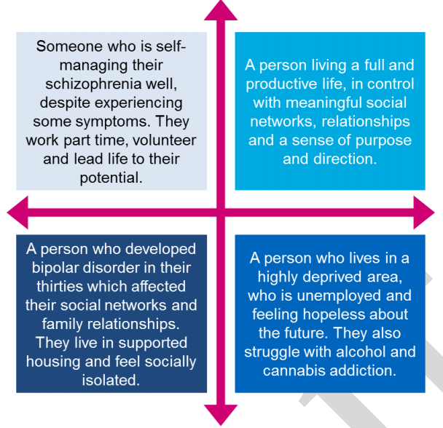
Exploring the relationship between mental health and emotional wellbeing
From Southwark Mental Health and Wellbeing
Strategy (Draft) 2017
High levels of emotional wellbeing
Every child included
Increasing levels of mental illness
Absence of mental illness
Low levels of emotional wellbeing
Notes:
You will need TOOLS 1.1.3 EWMH_Trajectories
Emotional wellbeing is not the same as mental health, and the terms should not be used interchangeably, although they are related. The diagram above* illustrates the inter-relationship between the two, with examples. *From Southwark Mental Health and Wellbeing Strategy (draft document) August 2017​
Mental health and emotional wellbeing​ trajectories
It is important to understand that a person's "position" in this grid can and will change, as moods and emotions swing through the course of a day. However, remove these daily fluctuations, and patterns can be seen and appreciated, which further exemplifies the intimate relationship between mental health and emotional wellbeing.​

Slide 20
Exploring the relationship between mental health and emotional wellbeing
Trajectories
Every child included
High levels of emotional wellbeing
A
D
F
E
Mental illness
Absence of mental illness
G
C
H
B
Low levels of emotional wellbeing
Notes:
TOOLS 1.1.3 EWMH_Trajectories
The grid can be used to grow awareness and understanding of the complex relationship between wellbeing and mental health.
Consider this diagram. Try to match the position and the trajectory (the letter) with the life circumstances of a child.
I will give you an example
Which Letter represents:
​A child with Down's Syndrome, who is vulnerable to depression, anxiety and ​social withdrawal, but has maintained high levels of emotional wellbeing due to supportive networks around them.

Slide 21
Exploring the relationship between mental health and emotional wellbeing
Trajectories
Every child included
High levels of emotional wellbeing
A
D
F
A child with Down's Syndrome, who is vulnerable to depression, anxiety and ​social withdrawal, but has maintained high levels of emotional wellbeing due to supportive networks around them.
​
E
Mental illness
Absence of mental illness
G
C
H
B
Low levels of emotional wellbeing
Notes:
And if you note Letter A next to Letter F- a child with very high levels of emotional wellbeing, but with high levels of mental illness. This represents a young person at the “manic” phase of bipolar mental illness (sometimes called manic depression). A crash is sure to follow, and we must be ready to understand and support.
NEXT CHALLENGE
Which letter represents a young person struggling with a serious eating disorder. Lapses and setbacks are occurring, but making slow progress towards emotional wellbeing.

Slide 22
Exploring the relationship between mental health and emotional wellbeing
Trajectories
Every child included
High levels of emotional wellbeing
A
D
F
A young person struggling with a serious eating disorder. Lapses and setbacks, but making slow progress.
E
Mental illness
Absence of mental illness
G
C
H
B
Low levels of emotional wellbeing
Notes:
FINAL EXAMPLE
A Child Looked After who is being bullied. It is having a severe impact on their emotional wellbeing, so much so that the young person is in danger of slipping into clinical depression.

Slide 23
Exploring the relationship between mental health and emotional wellbeing
Trajectories
Every child included
High levels of emotional wellbeing
A
D
F
A Child Looked After who is being bullied, in and out of school. It is having a severe impact on their emotional wellbeing, so much so that the young person is in danger of slipping into clinical depression.
E
Mental illness
Absence of mental illness
G
C
H
B
Low levels of emotional wellbeing

Slide 24
Activity 1.1.5
The emotional wellbeing of an education community
High levels of emotional wellbeing
Consider all the factors that could have a negative or damaging impact on the emotional wellbeing of a school community.
Some of these factors might be "momentous" (the result of a traumatic or unexpected event).
Some of these may be factors that have a corrosive, attrition​al or depleting impact, sustained over a period of time.
Mental illness
Absence of mental illness
Low levels of emotional wellbeing

Slide 25
Activity 1.1.5
The emotional wellbeing of an education community
Bullying and intimidation within school community (children and adults), within the wider community, cyber-bullying
Community attitudes and values Casual racism, sexism and gender discrimination; religious/cultural intolerance and expectations; threat and worry (e.g. FGM Female Genital Mutilation)
Looked After Children Insensitivity, poor communication, lack of awareness, stigmatisation.
Disaster Floods, fire, etc. within community or within countries of origin (if recent immigrants)
Parental attitudes towards learning, attainment and achievement (very high expectations… or very low expectations)
Overuse of punishment and sanctions Unyielding and inflexible behaviour policy and practice; whole class sanctions for the misbehaviour of a few; inconsistent use of detentions, isolation, fixed term and permanent exclusions
Domestic violence Everyday modelling of poor relationship management
Gang activity in the community (risk of street violence and harm, robbery, coercion, initiation rights, links to criminality)
Examination pressure impacting in different ways on different individuals (e.g. able children who do not perform well under pressure, learners with cognitive delay or specific learning difficulties, etc.)
Socio-economic disadvantage Children and young people feeling marginalised because of wealth gap within a school community
Death of a member of school community A member of staff, a child or young person, a well known figure in the community
Poor physical environment within school buildings, in homes, etc.
Notes:
Each pane will appear progressively as you click through

Slide 26
Achieving Wellbeing
Setting the scene
Discussion
In groups of 3 or 4, discuss the sources of stress and anxiety that impact on learning within the school community. Choose different perspectives:
A hard-pressed family
A child in care, a new immigrant or a child with an undiagnosed learning difficulty
A newly qualified teacher
A middle or senior leader… or a Headteacher
Notes:
Give time to this…. It’s meant to be cathartic.
Perhaps have flipchart paper and pens, or post-its. It is important to understand local anxieties and stressors.

Slide 27
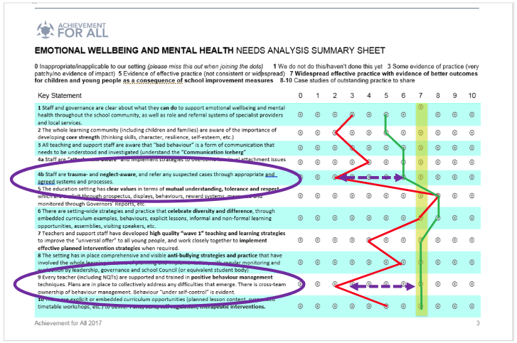
Achieving Wellbeing
Step 1 Needs Analysis
An assigned Achievement Coach will work with senior leaders/Governors to evaluate the impact of current policy and practice, identify strengths as well as areas for further improvement

Slide 28
Achieving Wellbeing
Step 2 Planning for change
Term 1
Unit 1.1
Term 2
Unit 1.2
Unit 2.1
Unit 2.2
Term 3
Unit 2.3
Every education setting is different.
The Needs Analysis can therefore be used to create a bespoke professional training route through the extensive resources.
Unit 3.1
Unit 3.2
Unit 3.3
Unit 3.4
Unit 4.1

Slide 29
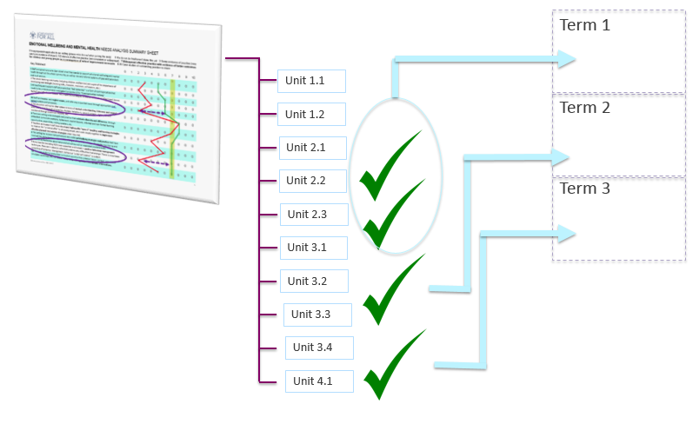
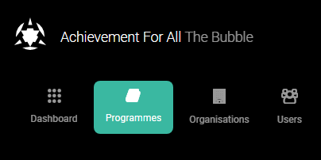
Achieving Wellbeing
Step 3 Supporting professional development
The Bubble is Achievement for All’s online professional development portal.
Every professional, including governors, can open an individual learning account.
The material is designed to support individual, small group and whole staff CPD.
All training materials are available 24/7 for a calendar year.
The assigned Achievement Coach is also available to lead a variety of training or evaluation activities.

Slide 30
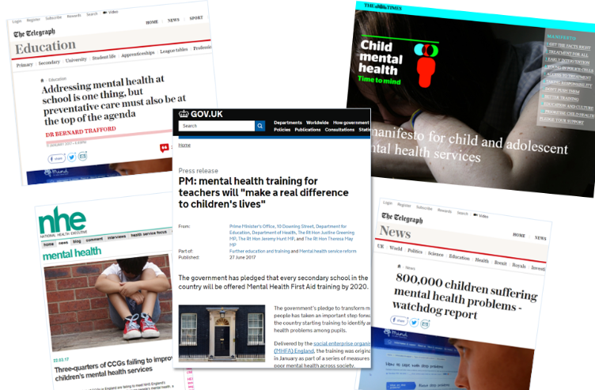
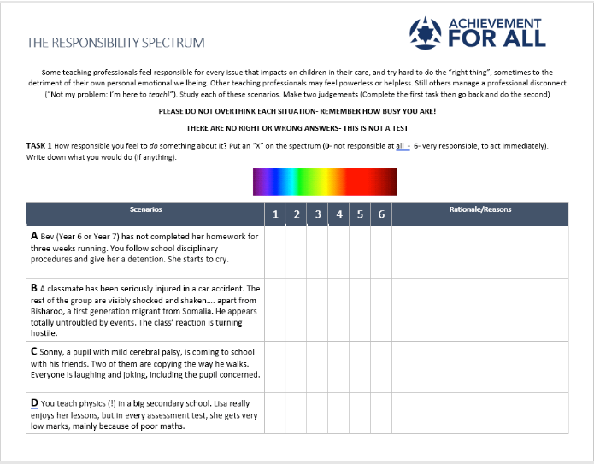
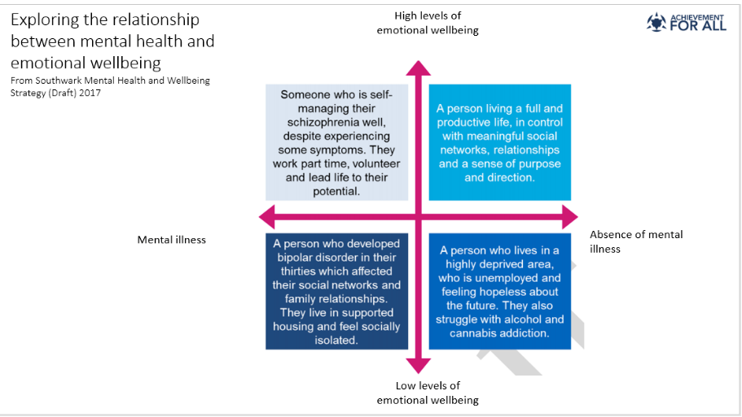
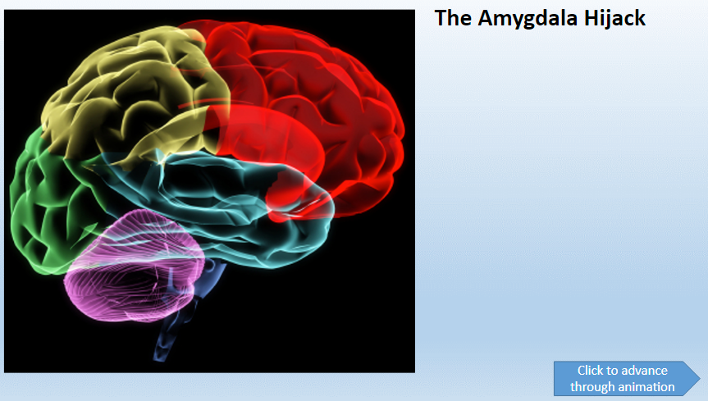
Achieving Wellbeing
The Materials
1 Emotional Wellbeing and Core Strength
Exploring the intimate link between academic progress and emotional wellbeing; the importance of whole school approaches, and how Achievement for All can support your setting's improvement journey.

Slide 31
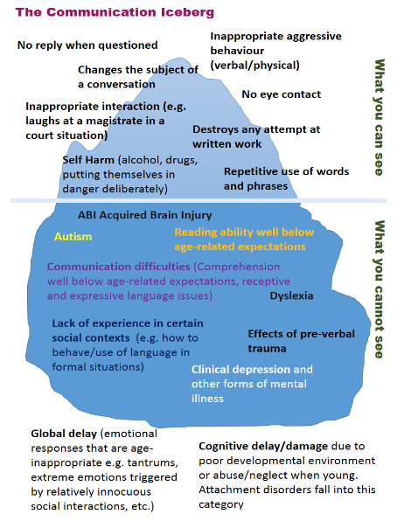
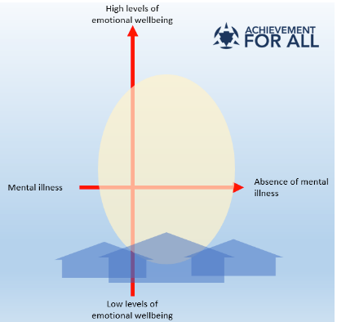
Achieving Wellbeing
The Materials
2 Making Sense of Behaviours
Gives education professionals a deeper insight into childhood trauma, neglect, attachment issues and the impact these have on the observed behaviours of children and young people.

Slide 32
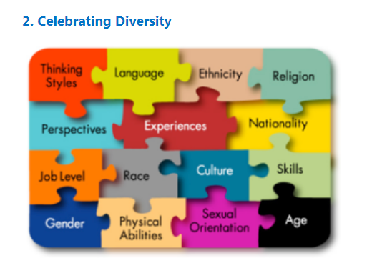
Achieving Wellbeing
The Materials
3 The Classroom Community
Offers a rich seam of developmental tools, strategies and approaches aimed at transforming the culture and climate of the whole education setting.
This is relevant to experienced staff as well as those who are newly qualified.
New ways of developing inclusive classroom practice and improving behaviour can be explored, introduced and embedded.

Slide 33
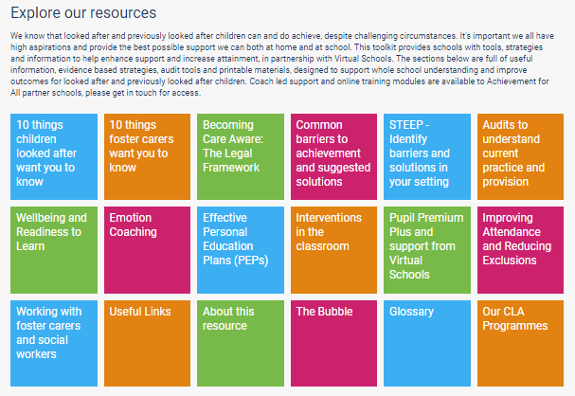
In addition (CLA Focus)
Free Designated Teacher Resources
You can access these without charge
https://afaeducation.org/free-dt-resources/

Slide 34
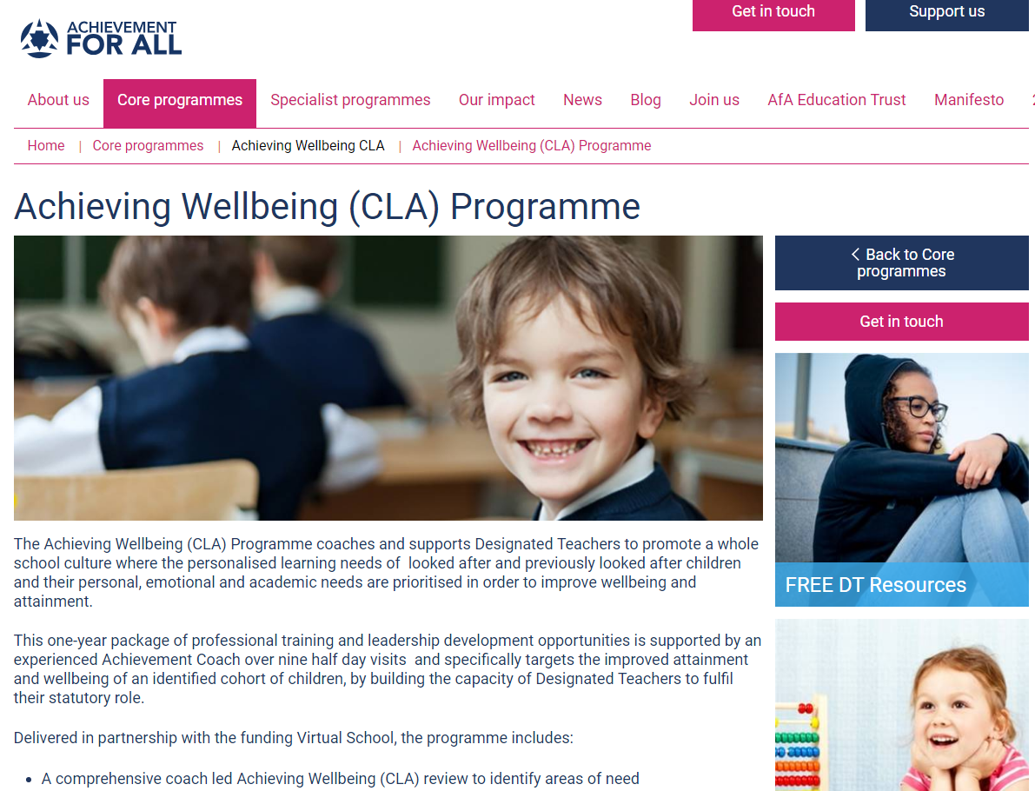
Some important links
Achieving Wellbeing
Achieving Wellbeing - CLA
https://afaeducation.org/
Main website
https://afaeducation.org/core-programmes/achieving-wellbeing/achieving-wellbeing/
https://afaeducation.org/core-programmes/achieving-wellbeing-cla/achieving-wellbeing-cla-programme/

